Slide 1


THE FUTURE OF INDIA’S “GIG – ECONOMY”

Slide 2


DISCLAIMER
The information contained in these documents is confidential, privileged and only for the information of the intended recipient and may not be used, published or redistributed without the prior written consent of Herody.
This document may contain certain future prospects which may be a forward-looking statements. Forward-looking statements by their nature involve a number of risks and uncertainties that could cause actual results to differ materially from market expectations. These forward looking statements represent only the Company’s current intentions, beliefs or expectations, and any forward-looking statement speaks only as of the date on which it was made. The Company assumes no obligation to revise or update any forward looking statements.
Note: All numbers have been rounded to the nearest digit for convenience of representation.

Slide 3
MAJOR CHALLENGES
High Unemployment
High unskilled labour
Changing Landscape
7.6 %
5 %
Impact of COVID 19
The country’s youth is
According to an article posted by the Business-Standard, only 5% of workforce in India is formally skilled
As we near the end of the pandemic, a new wave of “hybrid working” culture has
facing a huge problem in terms of employment opportunity.
emerged
Link

Slide 4





OUR SOLUTION – “GIG ECONOMY”
Gig economy has the potential to contribute to an incremental 1.25% to India’s GDP. We at herody have developed a robust online platform to unlock the doors of the gig economy and unleash its full potential
Qualified and trained gig workers for brands to employ
Multiple companies for gig workers to choose from
Herody is responsible for project completion and payments
Match right gig workers with the right companies

Slide 5



ABOUT THE COMPANY
Herody started with the vision of providing a gig work platform to brands & gig workers. We are a brand’s as well as gig worker’s best friends. We break down the complex business requirements in form of tasks and take ownership of end – to – end execution.
THE MISSION
To help popularize the gig economy in contribute to the nation’s GDP going forward
India and
THE VISION
To become the go-to market place for brand’s and gig workers to connect for all their business requirements

Slide 6



OUR FOCUS
At Herody, we focus on providing solutions for on-demand variable requirements of brands with our on-the-go Gig Workforce.
Our gig workers are well trained and specialize in completing the tasks on the go.
Digital Gigs
User acquisition
Tele-calling
Social Media Promotion
Online Campus Events
Content and data operators
Business Development
Hyperlocal Gigs
Offline Events
Audit
Last mile operations
Due Diligence
15

Slide 7







KEY FEATURES
Strong Network
100k + trained gig workers PAN India
Robust Tech Platform
Relevant pairing of enterprises with gig workers
Dynamic Capabilities
Meet variable on and on-demand needs of brands
Strong Experience
500k+ tasks completed over 200+ brands

Slide 8

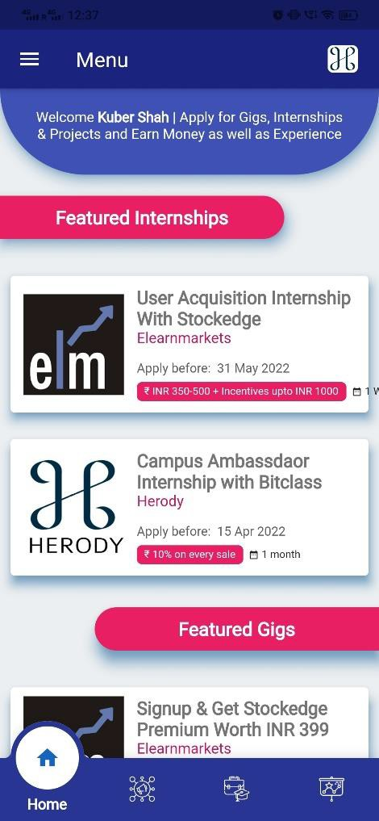
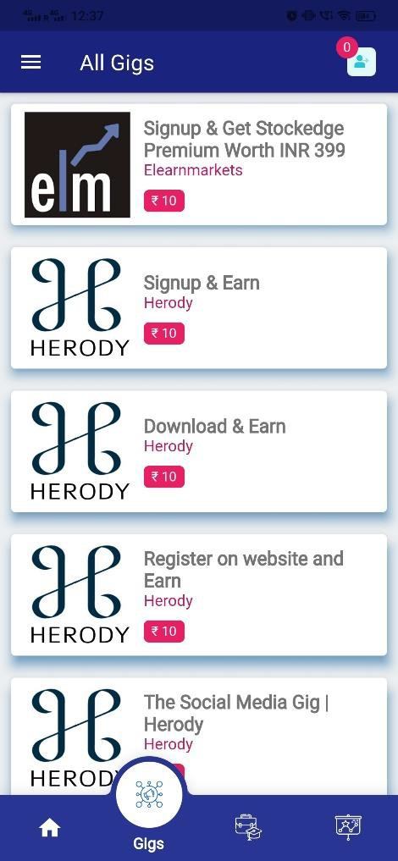
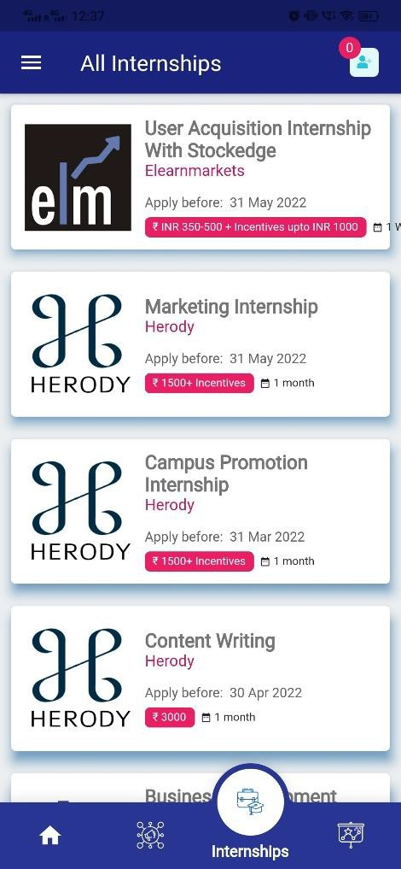
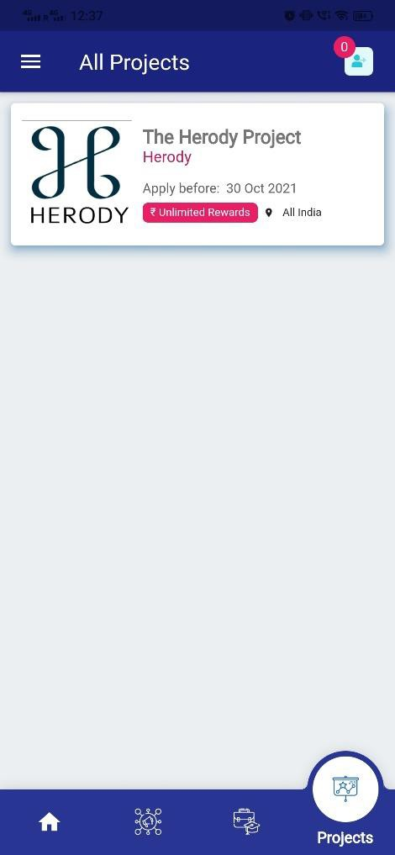

Slide 9
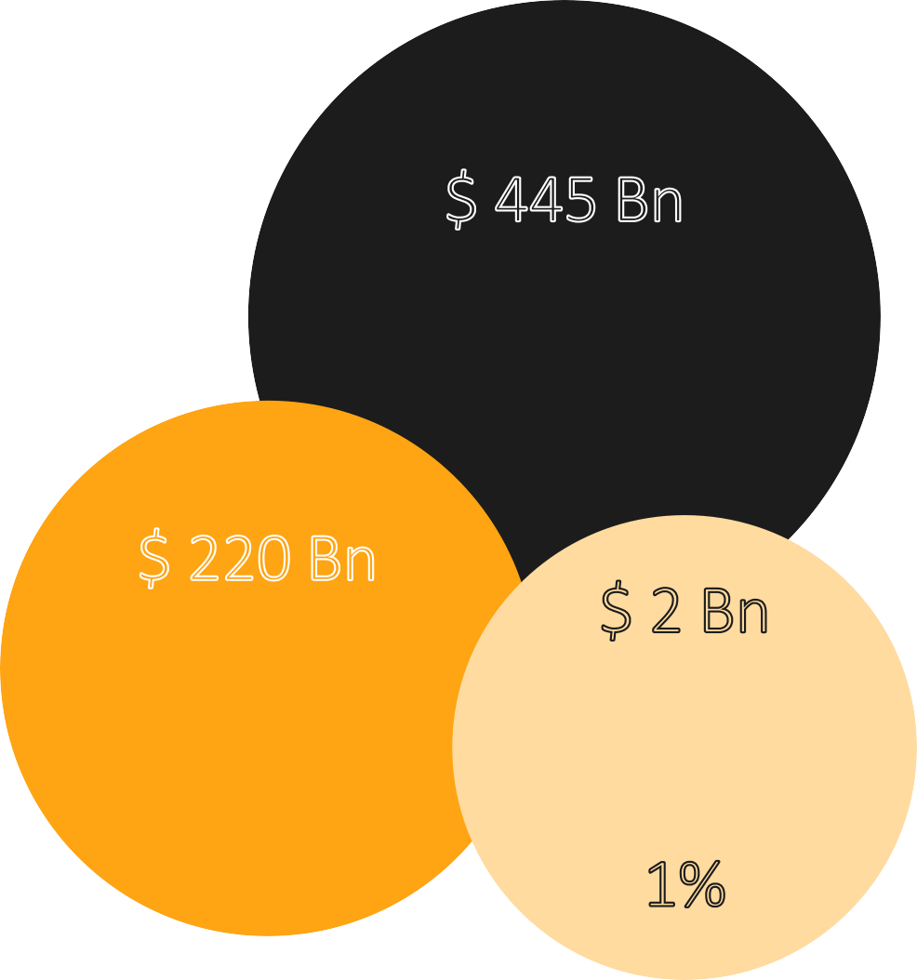
THE MARKET SIZE
The COVID 19 Pandemic has altered the way most companies do business. Many companies have realised the benefits of remote working, including saving costs of admin and utilities. This has given a big boost to India’s gig economy. The gig economy is expected to reach $ 445 Bn by 2024.
$ 445 Bn
Total Available Market
$ 220 Bn
Total Serviceable
Market (Digital Marketing
services)
$ 2 Bn
Serviceable Obtainable Market
1%
Source: ibef

Slide 10






COMPETITIVE LANDSCAPE
Focus on logistics, sales and after sales service
Focus on marketing and customer acquisition
Focus on on-demand outbound calling
Estimated Revenue of INR 100 Crores
Estimated Revenue of INR
8.5 Crores
Estimated Revenue of INR
2.5 Crores
Operations Cities
across
100+
Operations across PAN India
Operations across PAN India

Slide 11












MARKETING STRATEGIES
App / Website SEO
Tele - Calling
Social Media
App engagement
Organic search
Adwords / SEO
In-house telecallers
Cloud calling solution
Remote working
Influencer marketing
Social Handles
Retarget/Remarket
Blogs / Content
Online Engagement
Campus acquisition
Blogs on website
Affiliate content
Online Webinars
Campus ambassadors
Target College Events
College cafes

Slide 12






90%
REVENUE STREAMS
10%
100%
Workforce Solution
Commission Model
Offer Listings on the platform
INR 1000/Day/Offer
Job Postings on the platform
5% success fees
Promotion on our database
Providing gig workers as workforce solution to companies for a commission
TOTAL REVENUE EARNED

Slide 13



UPCOMING REVENUES
Subscription Model
Gig workers get guaranteed earnings of minimum of INR 5,000 every month from ease of their month.
Credit Line For Gig Workers
Gig workers can pay the amount by completing the work and a credit will be provided based on their work history

Slide 14
















CLIENTS SERVED
CLIENTS SERVED
We have served 200+ Clients in the last 20 months. We also have partnered with 1000+ educational institutions.
TOP INSTITUTIONS

Slide 15
























CLIENTS SERVED

Slide 16







MILESTONES ACHIEVED
1,00,000 +
Network of trained gig workers PAN India
5,00,000 +
Total number of projects completed
1.22 Crore
Revenue Achieved
200+
Brands tie – up with
20
Months in Operations
4.4 *
Rated on Google Play store

Slide 17
FINANCIAL HIGHLIGHTS
Revenue, EBITDA and PAT (INR Lacs)
1200
1000
800
600
400
200
0
-200
 | FY21 | FY22 | FY23 | FY24 | FY25 | FY26
Revenue | 36.56 | 84.6 | 221.8 | 415.3 | 612.1 | 1,015.3
EBITDA | -0.07 | -45 | -15 | 71 | 160 | 363
PAT | -0.07 | (104.30) | (49.84) | 56.03 | 138.65 | 268.12
Revenue EBITDA PAT

Slide 18


MEET THE FOUNDERS
RAJDEEP SINHA
Founder and CEO
SAKHTI SWAROOP
CBO
Rajdeep holds Btech in engineering and served as CMO for Storiesofcommonman. As a result of his insights, Herody was founded to fill a void in the gig economy. He leads a team at Herody that attracted 100,000 customers, worked with over 300 companies, and produced INR 2 Crores in revenue in just 2 years.
A 5-year company development veteran, Swaroop is a Tedx Speaker, a two-time entrepreneur, and M.Tech from NIT, Surathkal. He's previously founded two firms, one of which was acquired, and his startup and advisory work has been covered in numerous newspapers. Swaroop joined Herody later in the process since he was a huge proponent of the notion.

Slide 19


MEET THE TEAM
Sahilendra Damaraju
CTO
Rini Sinha
COO
A Software Developer by Profession, has 5 years of experience in developing applications. Worked as CTO at TAM Ascend & Stack Nation. Also worked as a technology consultant for Tutkins, AFM, etc. He is currently leading the Tech Team at Herody.
Rini is having an experience of over 5 years of working in product marketing and operations role in multiple companies. She is managing operations at Herody since inception.

Slide 20
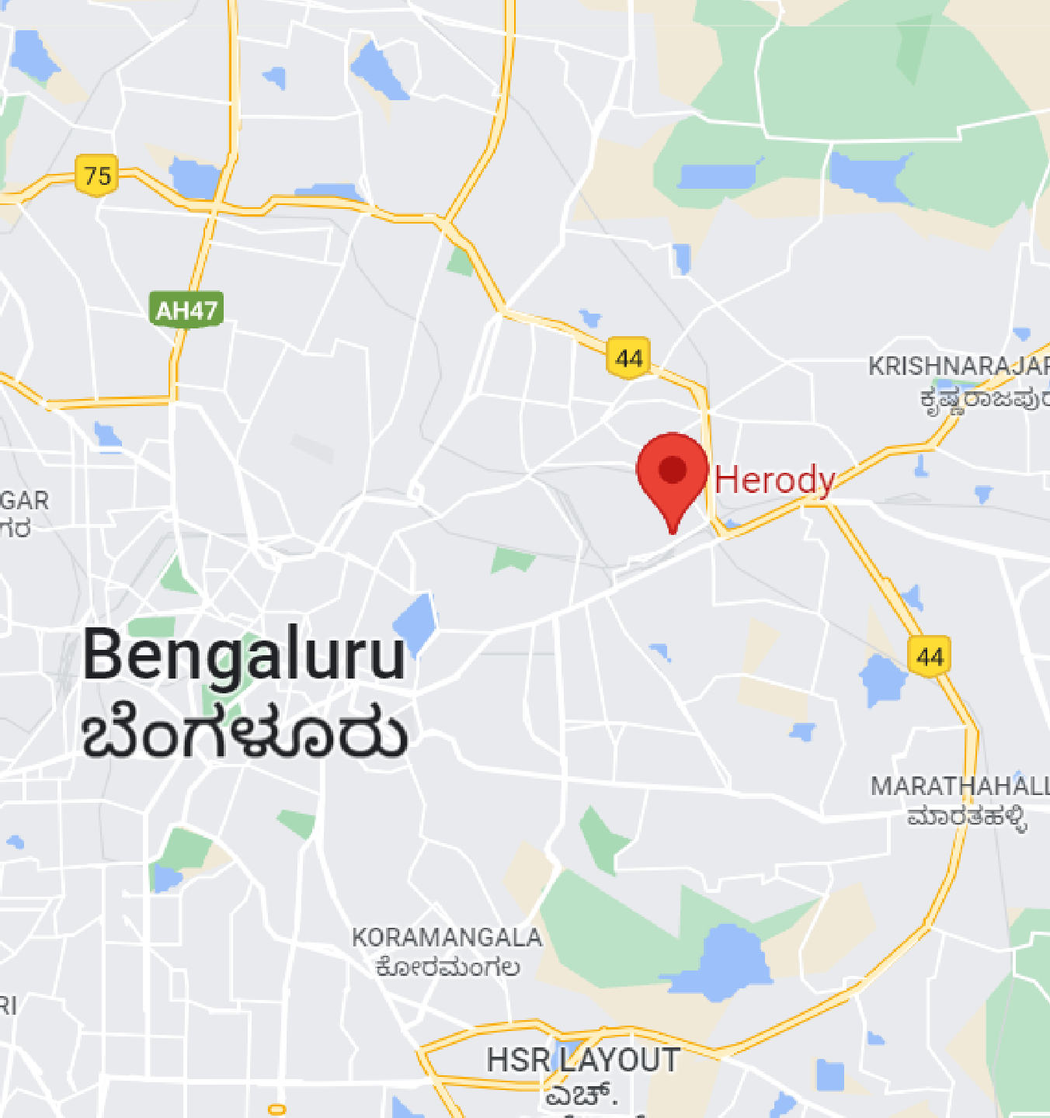



THANK YOU!
Get in Touch
2nd Floor, Suite No 39, 245, NGEF Lane, Indiranagar, Bengaluru, Karnataka, 560038
raj@herody.in
www.herody.in

